Slide 1
Graduate Admission Project

Slide 2
INTRODUCTION
There are very many universities in the world, but everyone wants to attend a prestigious one. As the number of available seats in it is much less than the number of students, every student may not be able to go to an university of his / her choice. Given various parameters such as standardized test scores, letters of recommendation, CGPA etc, the aim is to create a model that provides the probability that a certain student gets admitted to a particular university. Universities retain historical data pertaining to student admissions, using which I have trained different machine learning models, like Linear Regression, Random Forest Regressor and Decision Tree Regressor. After which I compare the outcomes or the working of these models on a test data set. In the end, we can then use the best performing model as a way to predict the outcome of university graduate admissions.
This project addresses machine learning models to predict the chance of a student to be admitted to a master’s degree program in the United States.

Slide 3
DATASET
The dataset used in this project was sourced from Kaggle. This dataset was built with the purpose of helping students in shortlisting universities with their profiles. This dataset is inspired by the UCLA Graduate Dataset. The dataset contains several parameters which are considered important during the application for Masters Programs.

Slide 4
DATA ATTRIBUTES
INDEPENDENT VARIABLES :
GRE Score out of 340
TOEFL Score out of 120
University Rating out of 5 points
Statement of Purpose out of 5 points
Letter of Recommendation out of 5 points
Undergraduate GPA out of 10
Research Experience either 0 or 1
DEPENDENT VARIABLES :
Chance of admission : From 0 to 1

Slide 5
METHODOLOGY
Calculating chance of admission using ML Algorithms include the following stages.
Data Preprocessing : The data is made ready for further analysis. The bad values are ignored or replaced, missing values are filled or those entries removed. We check for any null values in the dataset.
Feature Selection : In this step the important and necessary features for prediction of chance of admission are selected. We remove the serial number column from the data as it is not related to the outcome.
Data Visualization : In this step visual description of the data is provided, so as to give a sense of what the data is

Slide 6
Training and Testing data: The dataset is split into training data and testing data. The model gets trained by the training set and this trained model will be used to test if the predictions are made correct or not.
Training the Model : Now we train different ML models with the training data set. The results are then analyzed.
Performance Analysis: The algorithm with the highest accuracy is chosen as the best method to predict the dependent variable from the independent ones.

Slide 7
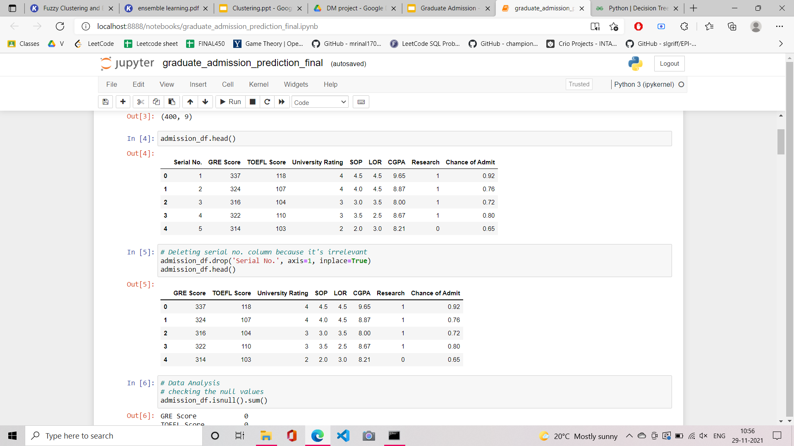
FEATURE
ELIMINATION

Slide 8
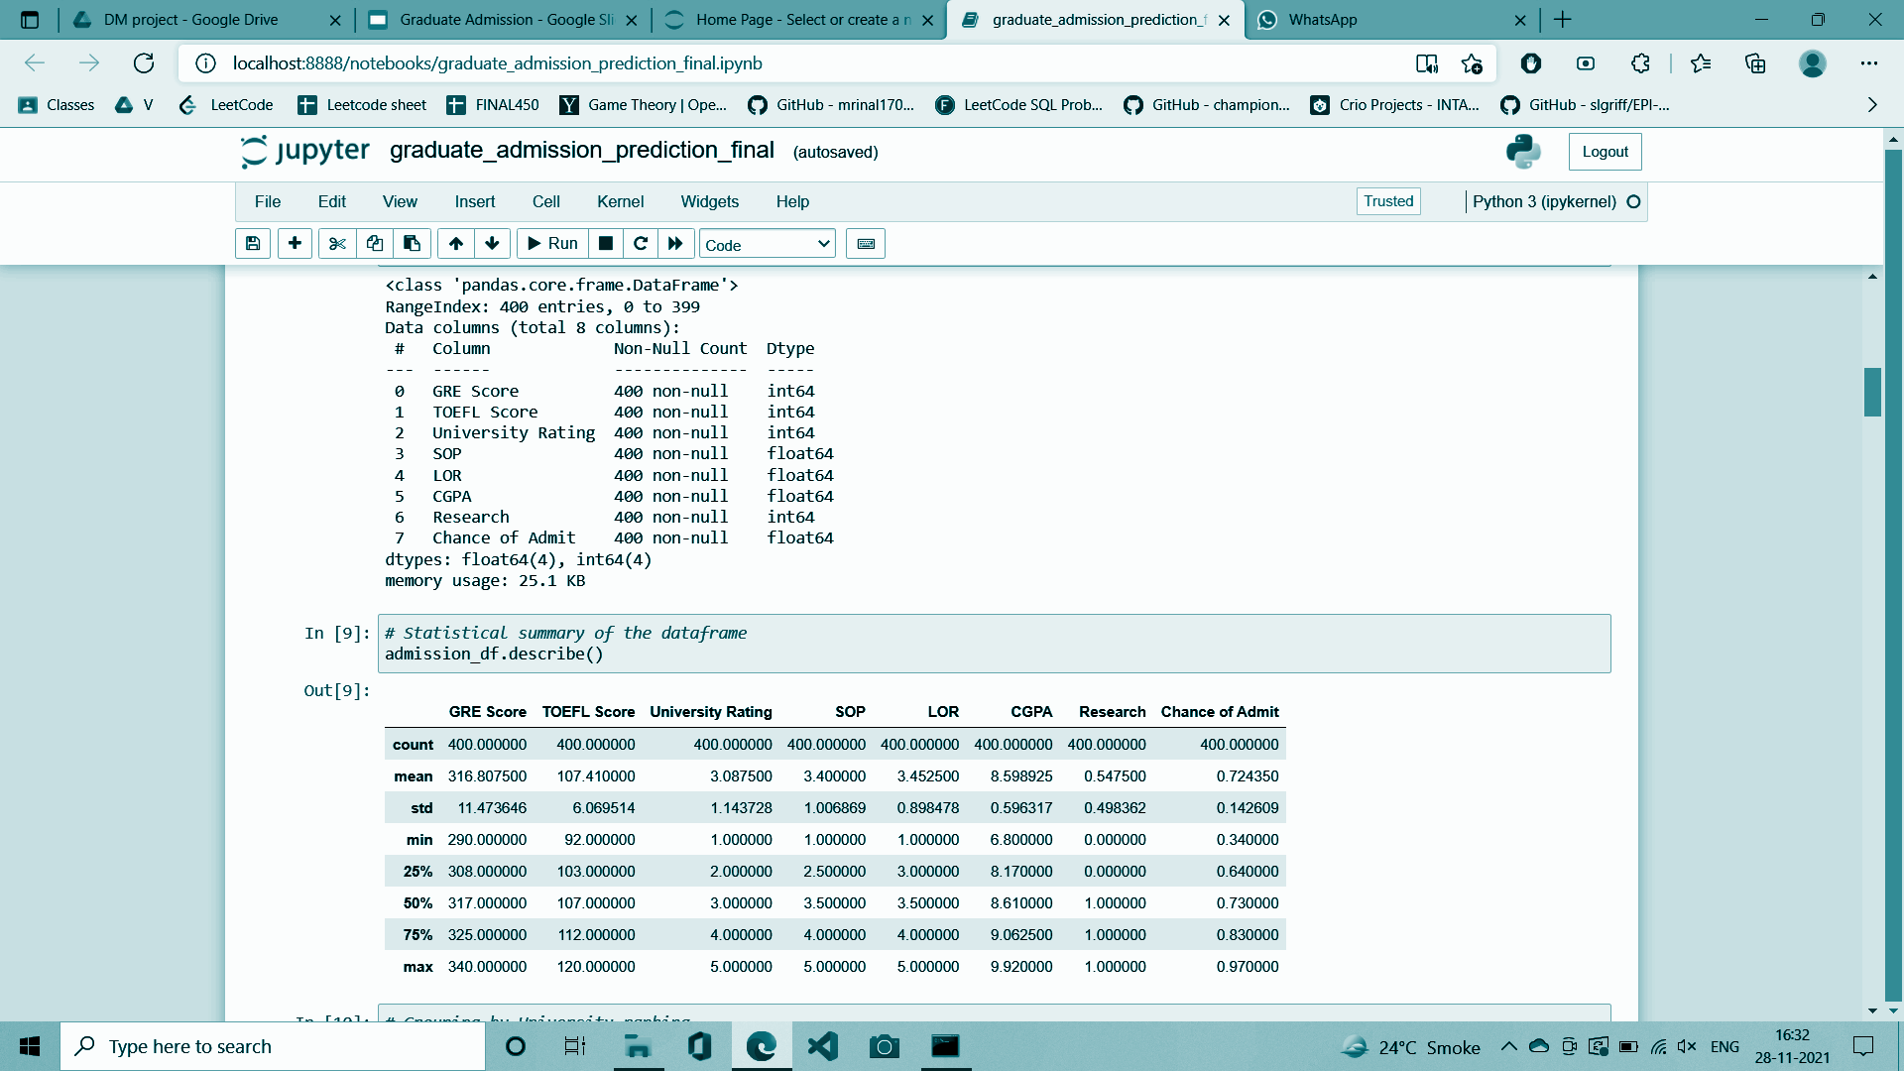
DATAFRAME INFORMATION

Slide 9
STATISTICAL SUMMARY OF DATA

Slide 10
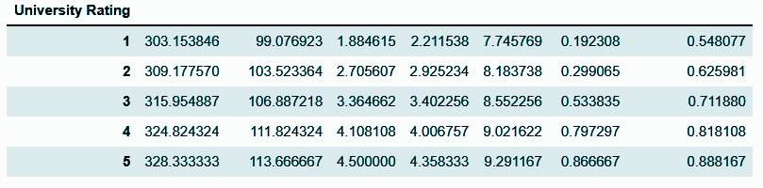
GENERAL TREND FOR EACH UNIVERSITY TYPE

Slide 11
Data Visualization
Data visualization techniques provide an accessible way to see and understand trends, outliers and patterns in data using visual elements like charts, graphs and maps. It help in visualizing phenomenons that cannot be observed directly.
I have used the following three visual elements to visualize our data:
1. Histogram
2. Pairwise plot of features
3. Heatmap of Covariance matrix

Slide 12
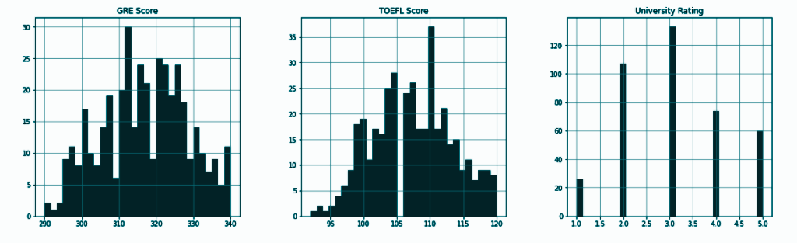
Histogram
Histogram : Shows frequency distribution

Slide 13
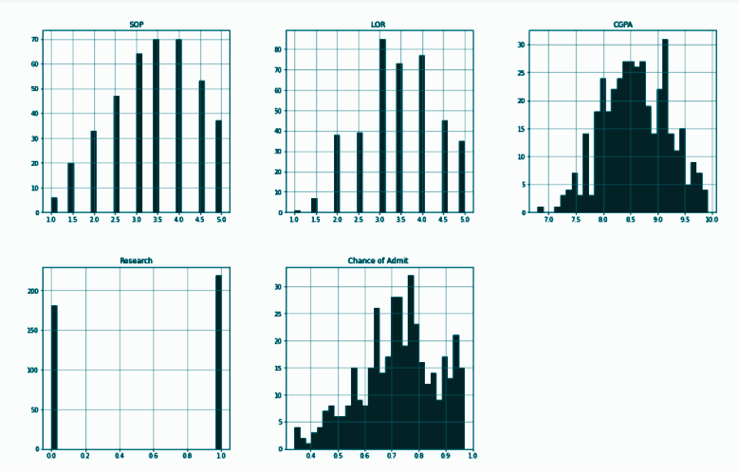

Slide 14
Pairwise Plot
A pair plot allow us to see distribution and relationships between two variables.
Pair plots are a great method to identify trends for follow-up analysis and are easily implemented in python.
I have used seaborn visualization library to plot pairwise in our project.

Slide 15
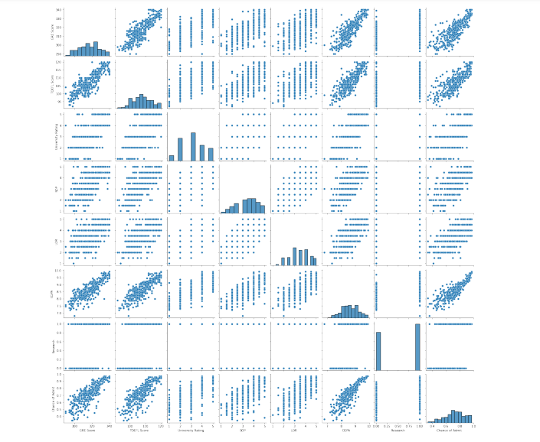

Slide 16
Covariance Matrix
A Covariance matrix is a table showing covariance coefficients between variables.
I have used heat map from seaborn library to depict the covariance matrix.
A heatmap is a graphical representation of data where each value of a matrix is represented as a color.

Slide 17
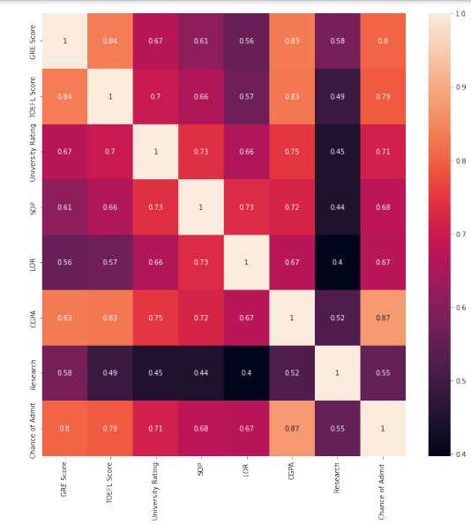
Rank of features
1.CGPA
2.GRE Score
3.TOEFL Score
4.University Rating
5.SOP
6.LOR
7.Research

Slide 18
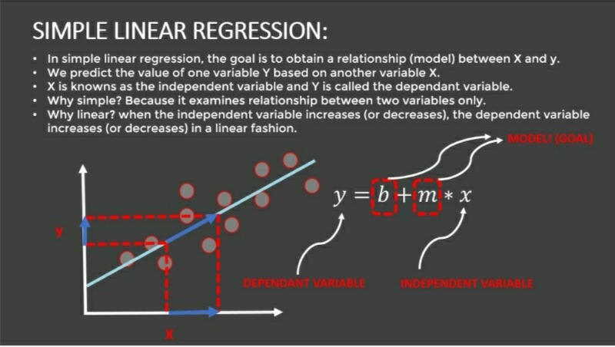

Slide 19
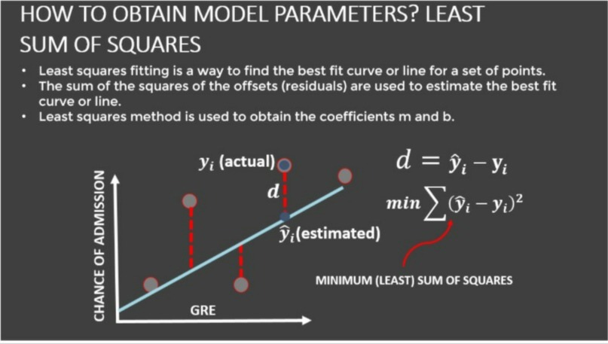

Slide 20
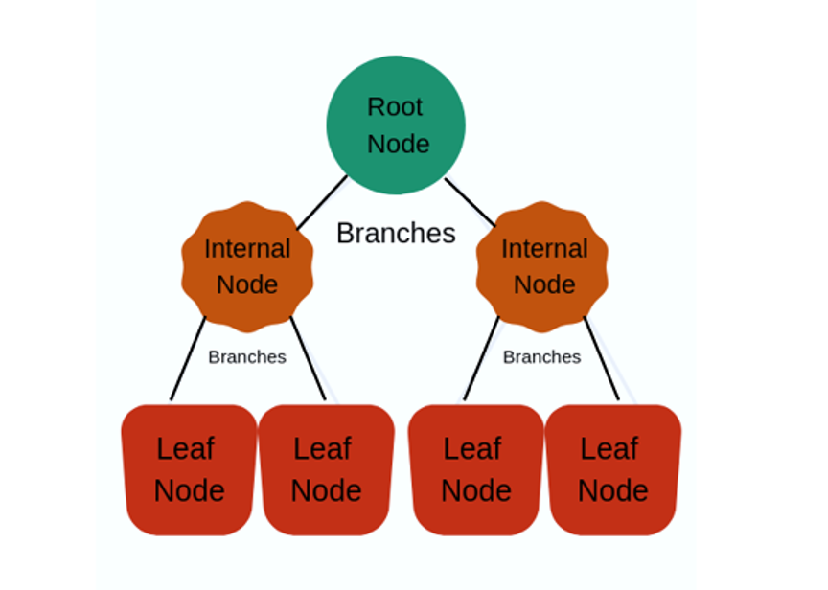
DECISION TREE:
The model works by creating a tree-like structure by dividing the data- set into several smaller subsets based on different conditional logic.
The main components of the decision tree are the decision nodes, leaf nodes and the branches.
Nodes with multiple branches are the decision nodes, nodes with no branches are called the leaf nodes, and the top node is called the root node.

Slide 21
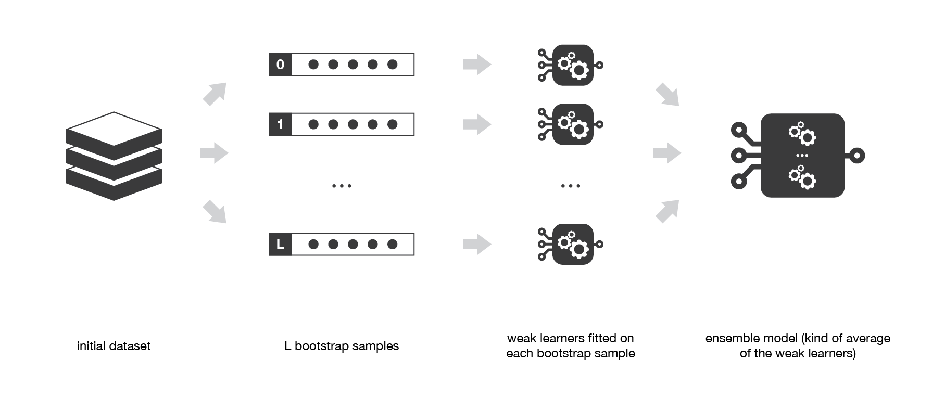
Random Forests
Random Forest is a collection of decision trees.
First the samples are collected from the dataset using bootstrap sampling and decision trees are constructed for each sample and we collect outputs from all decision trees and the highest counted output is considered.

Slide 22
RESULTS AND DISCUSSIONS
MODEL | ACCURACY
LINEAR REGRESSION | 0.8447139984768293
DECISION TREE | 0.7308218731669165
RANDOM FOREST | 0.7622919293271224
The Best Model is Linear Regression

Slide 23
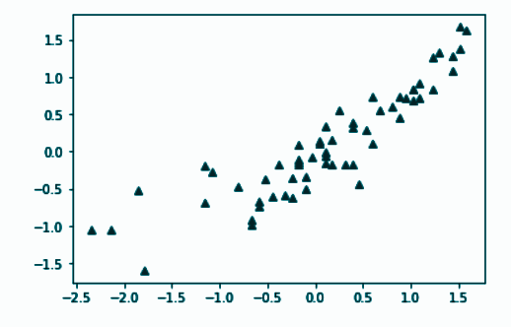
REGRESSION MODEL PERFORMANCE ON TESTING DATA
Root mean square error = 0.072
R2 = 0.7854659918865505
Adjusted R2 = 0.7630519910388767

Slide 24
CONCLUSIONS
Able to predict opportunity of a student to get admitted to a master's program.
Based on the tests done in this project, Linear Regression model surpasses other models.
Explored important factors affecting Chance of Admission.

Slide 25
THANK YOU
I hope this project can help students guess whether to apply for a master's degree or not.

